Slide 1
Infrastructure for REDD+ In-country Development
Forest Carbon Partnership Participants Committee
Jane Lloyd \ Santa Marta \ June 29th 2012
Notes:
Thank you Anja for the introduction. Thank you to the FCP for the invitation to address you and observing countries. I am impressed with in country program developments. I represent one of the four registry providers worldwide. We have worked in number of areas to ensure that we start to develop understanding of the countries needs for REDD+ registries within the readiness – worked on white paper for KfW with Climate Focus, we are on the VCS jurisdication REDD technical committee, we register a majority of the worlds REDD+ voluntary standards.

Slide 2
Agenda
Roles of Policy Makers and Infrastructure Providers
Phases of Infrastructure Development for In-country REDD+
Developing Program Infrastructure Issues and Considerations
Notes:
Today I would like to discuss with you and give some context for registry providers, share some practical implementation considerations and some possible issues and solutions as you start to address your strategic readiness criteria in section 2.
Registries can help ensure confidence, integrity, transparency and efficiency of information relating to ERPs (Envrionmental Reduction Programs), and any units and / or payments issued for it. When designing REDD+ incentives, financing mechanisms and payment-based programs, registries will be required to play a key role ensuring that important information is captured, processed, stored, and accessible when required. This will help promote the credibility of REDD+ reductions and ensure that there is one aggregated and centralized repository of information to record and disclose this information.
In a REDD+ context, regardless of whether a market-based mechanism is established, a registry can aggregate and track multiple levels of ERP activity (national, subnational and project-based) and can provide governments and donors with transparent and meaningful data from which to make performance- based payments. For the purposes of this report, the term “registry” therefore refers to the electronic infrastructure designed specifically to ensure accurate accounting of ERPs and their respective performance (measured either through emission reductions or removals, or another agreed performance metric) as well as the issuance of REDD+ units or the recording of performance-based payments, irrespective of whether the units are transacting within a market framework.

Slide 3
Roles of policy makers and infrastructure providers
Roles in REDD+ Program Development
    Government authorities role:
    set the environmental priorities through the development of policy, rules and guidelines;
    they also establish or authorize the criteria by which environmental benefits and credits can be created;
    key stakeholders and addressing the publicwith key program information
    Infrastructure provider role:
    respond to policy signals;
    set the foundation for market operation registry, establishing documentation and marketplace functionality;
    work closely with governments and funds to provide access and reporting to ensure the appropriate transparency and oversight
Notes:
It is important to note that registry technology is essentially database driven and is not particularly complex if designed correctly from the start. However, it needs to be based on clear policy requirements and procedural considerations, and that is where most of the complexity comes in. As a key element of a country’s institutional framework for MRV, registries are meant to be neutral tools responsive to the informational and infrastructural needs of participants based on laws, rules, practices or guidance. The registry is an enabler, not a driver of policy. Therefore, it is not the role of the registry provider to make subjective assessments of matters that need to be addressed by policy makers and law, such as e.g. rules for the definition of reference levels, procedures for the verficiation of information and approval of REDD+ actions, measures to address leakage and non-permance, benefit-sharing and carbon rights, as well as compliance with standards or a potential moratorium.

Slide 4
Pathway to REDD market development
Phases of the REDD program development
Pre-requisites:
Governmental Environmental Policy
Environmental Program Design
Stakeholder Engagement and Public Comment
Results:
Public Reporting
Market Monitoring
Market Commentary
Guidance
Phase 1
Program Definition
Liquidity
Phase 3
Market Services
Transparency
Phase 2
Registry Services
Notes:
Phases in infrastructure development is phased to meet the needs of the REDD+ program development – modular approach to maintain the right level of development and transparency for the country.

Slide 5
Pathway to REDD program development
Infrastructure needs the REDD+ markets
Phase 1 –
National Reporting Database
Inventory (forested/deforested areas)
Baseline and target data
Reductions Reporting and Benchmarking
FundingTracking
Phase 2 – Environmental Registry
Projects registration
Credits issuance
Credits transfer and retirement
Public views of credits
Phase 3 –
Market Services
Introductory Platform for buyers/sellers
Auctions
Connectivity to Exchanges
Settlement services
Pricing and volume reporting

Slide 6
Pathway to REDD+ market development
Infrastructure for REDD+ markets
Program Tracking Tools
National Reporting Database
Project Workflow
Environmental Registry
Trading and transactions
Manage
Programs
Manage
Projects
Register
Projects
Issue
Credits
Post Interest
on RFI
Participate
In
Auctions
Connect to
Exchanges ,
Settlement
Agencies
Track Transfers
Post Trade Information & Services
Program Developers
Project/Jurisdictional Developers
Project/Jurisdictional Developers
Funders
Validators / Verifiers
Regulatory Agencies
Buyers
Domestic ETS participants
Governments
Banks
Traders
Retailers
Corporate Buyers
Long term Investors
Speculative Buyers
Traders / Brokers / Investment Banks
Program Participants
Exchanges and Clearing Houses
Program
Design
Project
Design
Project
Validation
Project
Operation
Verification
Auctions

Slide 7
Phase 1 – National Reporting Database
Phase 1 - Program Reporting Database:
    Provides transparency and displays critical information of the REDD+ programs to the public
    Establishes reports on performance metrics
    Benchmarks region’s data against other data sets
    Funding tracking to non-market and market based environmental outcomes and public reporting
    Provides secure and national management tool for public reporting

Slide 8
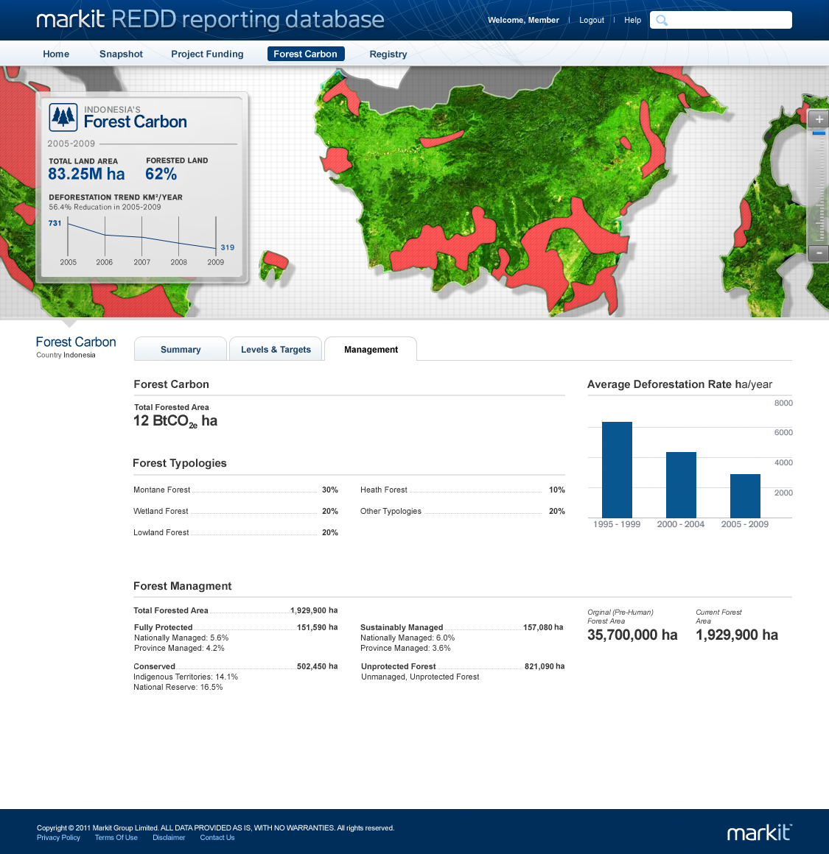
Phase 1– National Reporting Database
Carbon Accounting Page
Notes:
Example of National Reporting Database we have established for an international organization with multiple contributing sub nationals:
Includes some standardized reporting and some customizations that I will discuss later the importance
Forested areas – Forest typology-Forest management (protected, conserved, sustainable management-unprotected)
Average deforestation rates
Other pages can include reporting of level targets/ reference levels and funding and performance based metrics

Slide 9
Phase 2 – Environmental Registry
Phase 2 - Environmental Registry provides:
    “Know Your Client” checks before account opening
    Tailored account opening procedures applicable to the program
    Levels of security and checks that comply with the highest international industry standards
    Automation of data entry to reduce double entry
    Activity Log ofall activity
    REDD+ credit serialization and tracking throughout lifecycle
    Fully searchable Public View with full market visibility of national, sub-national, projects, program outcomes and transactions
    Data outputs that can be used to support reporting requirements
    Regulator approval capability (accounts, issuances, transfers)

Slide 10
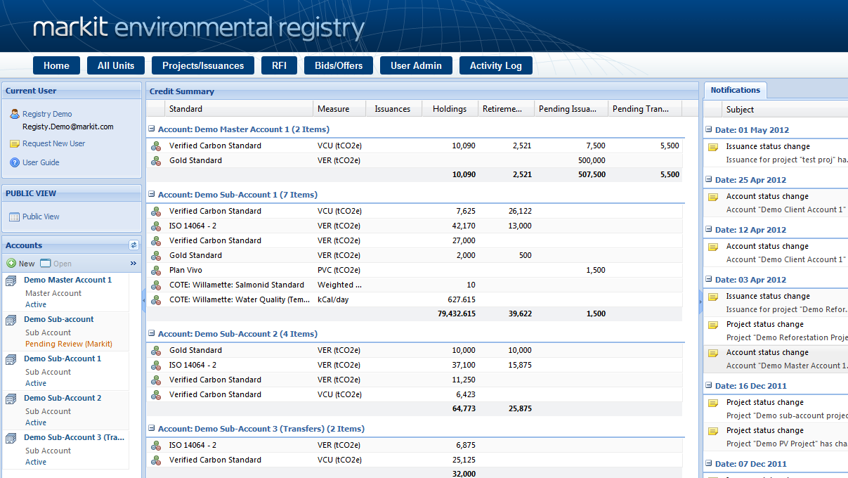
Phase 2 – Environmental Registry
LandingPage
View credit summary, notifications and accountholder details on the Registry’s landing screen
Access all Registry pages, includingcredit issuance (creation) by standard or environmental asset type

Slide 11
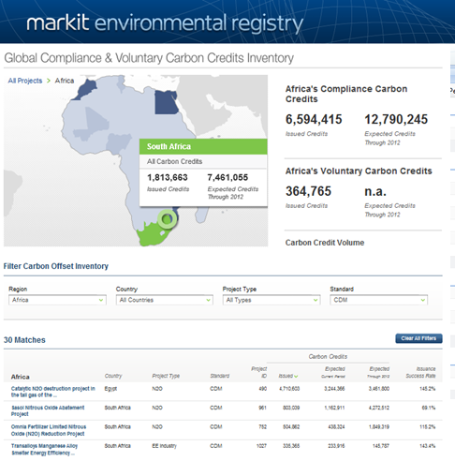
Phase 2 – Environmental Registry
PublicView
Allows public to view account details, crediting, transfer, retirements
View on map to show distribution ofactivity
Access links tocreditingdocumentation
View aggregated data for crediting by project, state, country, and region.

Slide 12
Phase 3 – Environmental Markets Trading Platforms
Phase 3 - Market Connectivity Services:
    Registries
      Integrated to avoid double counting and validation of information
    International Databases (e.g. ITL or VCS Database)
    Over-the-Counter Platform
      Platform that enables market participants to connect and explore credit offerings
    Settlement Services
    Exchange Connectivity
Notes:
Storing key information relating to any emission reductions program in a registry increases visibility and comprehension of the program, preserves optionality in the future and it can facilitate the tracking of verified emission reductions.
However, where the jurisdiction in which the ERPs operate supports a marketplace for REDD+ units, then the rationale for a properly designed registry must meet financial markets standards. Establishing clarity around the nature and ownership of any asset is critical to enable it to transact a performance payment efficiently and with confidence.

Slide 13
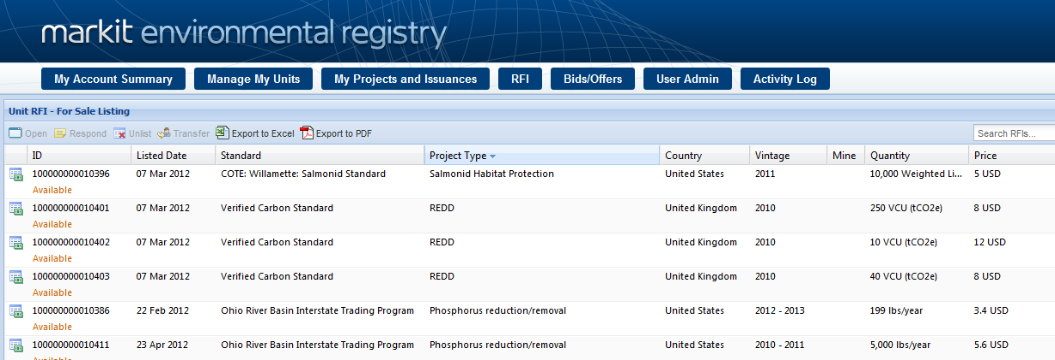
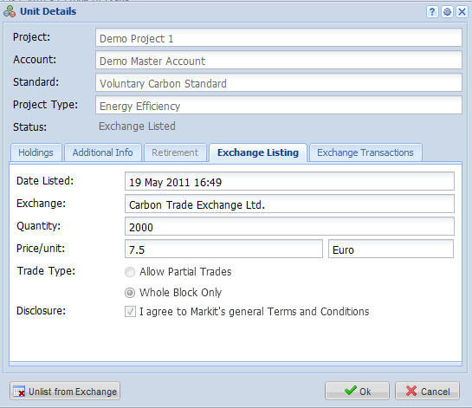
Phase 3 – Environmental Markets Trading Platforms
Introductory Platform – matching buyers and sellers
Exchange listing status screen

Slide 14
Pathway to REDD market development
Developing program infrastructure potential issues
    Proliferation or fragmented REDD+ registry infrastructure:
      differing quality and functionality
    Lack of consistency for REDD+ asset accounting and reporting across registries
    Lack of scalability to regional, continental and international levels
Notes:
If each country builds it own registry to track baselines and credits within its borders, these systems would not be compatible and data exchange and validity would be without substantial investment of money and time. Building registries is expensive and the success rates are very low. Existing model and providers can partner with countries in REDD+ registry design and implementation and the development of registry technical and operational protocols.

Slide 15
Pathway to REDD market development
Developing program infrastructure considerations
    Infrastructure key in supporting REDD+ in-country program development
    Infrastructure should be included early within the ERP and MRV discussions for REDD+ program design
    Infrastructure can be implemented by countries in phases that align with the in-country needs and customized to meet countries program development stages
    Potential issues can be resolved when countries work together to standardize programs and infrastructure across countries is important for the development and credibility of REDD+ worldwide
    Cost for implementation of international standard infrastructure and process can be reduced when funders or international bodies cancore standardization that could be also further customized for the countriesrequirements
Notes:
The core difference between the compliance registry network and registries operated in the voluntary carbon market centres on the very different origins of the two markets. In the compliance market, the Kyoto Protocol accounting and reporting rules acts like one very large carbon standard overseen by an overarching secretariat pursuant to a set of internationally agreed requirements governing issues such as infrastructure, issuance, and treatment of the units created.
However, the voluntary carbon market arose from a completely different context and comprises a number of different carbon offset accounting standards all with differing rules, infrastructure requirements and in most cases without any overarching standards body actively approving issuance and treatment of the units created. The standards and documentation existing in the voluntary carbon market focus almost entirely on the supply side of the market (i.e. what has to be done in order to have a units issued). While the demand side has numerous drivers, almost all of them arose as the market evolved or more recently government rule or guidance on the types of units that can be purchased in such jurisdictions.5
Over the past 3 years, the administrative bodies/boards of the main 6-8 voluntary carbon accounting standards have taken different approaches when using registries to track issuance of units under their standards. Most major standards are linked with a third party registry provider and some standards authorities (such as the Voluntary Carbon Standard Association - VCSA) have established a very structured approach to registry operations including drafting operating procedures and audit requirements. Other standards authorities are less involved in the registry functions and procedures.

Slide 16
Thank you.

